Slide 1
Advanced Github Topics
Instructor –
Zach martin

Slide 2

Initial resources and Introductions
https://github.zach-martin.com/advanced.html
A quick introduction –
Zach Martin
17 years IT experience
5 years professional software development experience
Father to a nineteen-month-old baby girl

Slide 3
Presentation Objectives
Gitflow Strategy Refresher
Advanced Git Tactics
Rebase – What it is and when to use it
Forking vs. Cloning
Tags – $20 in my pocket?
Advanced GitHub Features
Actions and Workflows to build a CI/CD Pipeline
Templates
Secrets and how to use them
Pull Request Management
Issue Tracking and Projects

Slide 4
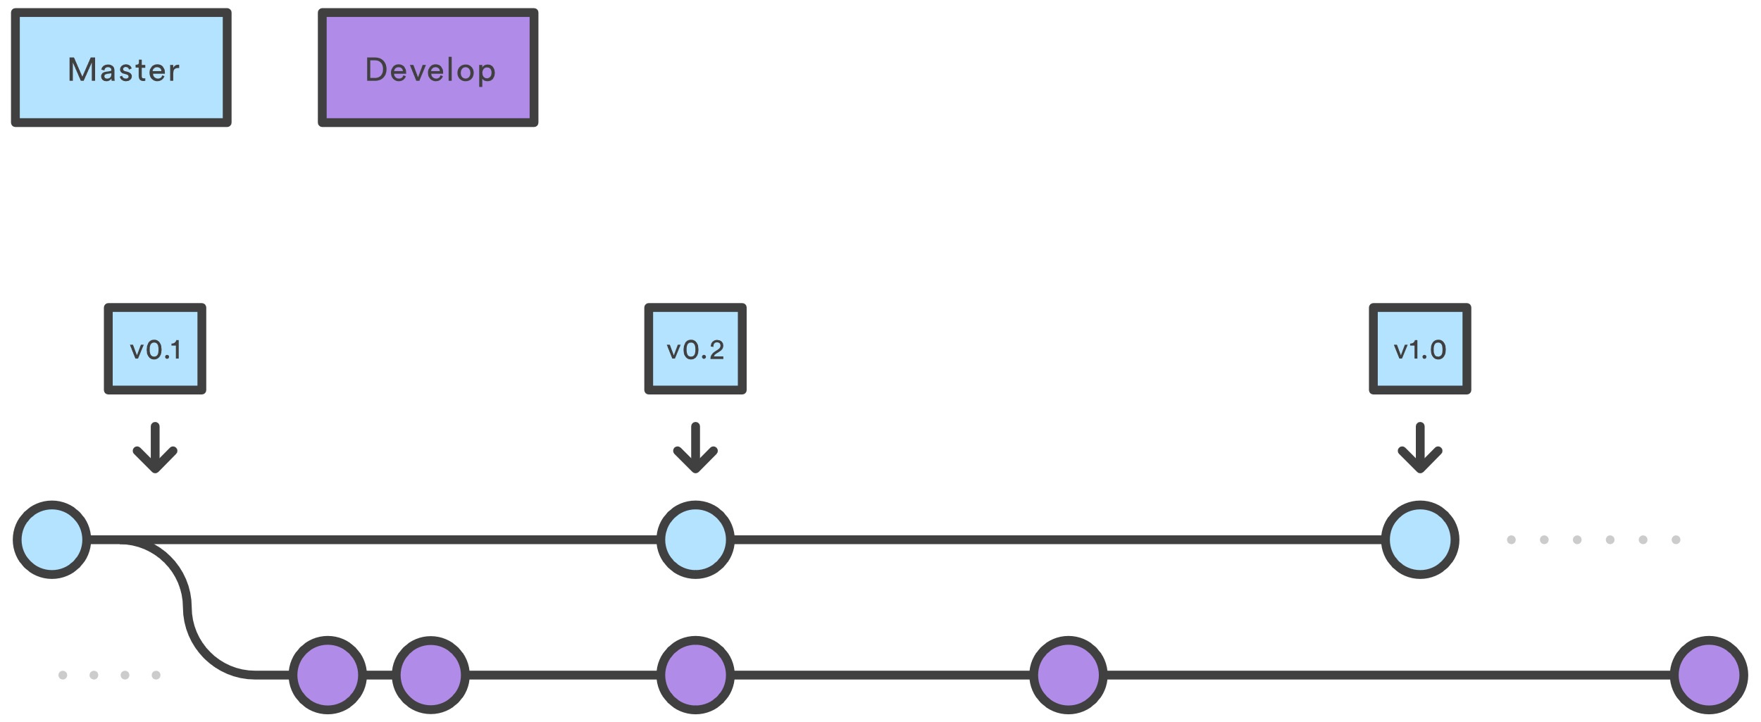
Branching strategies - Gitflow

Slide 5
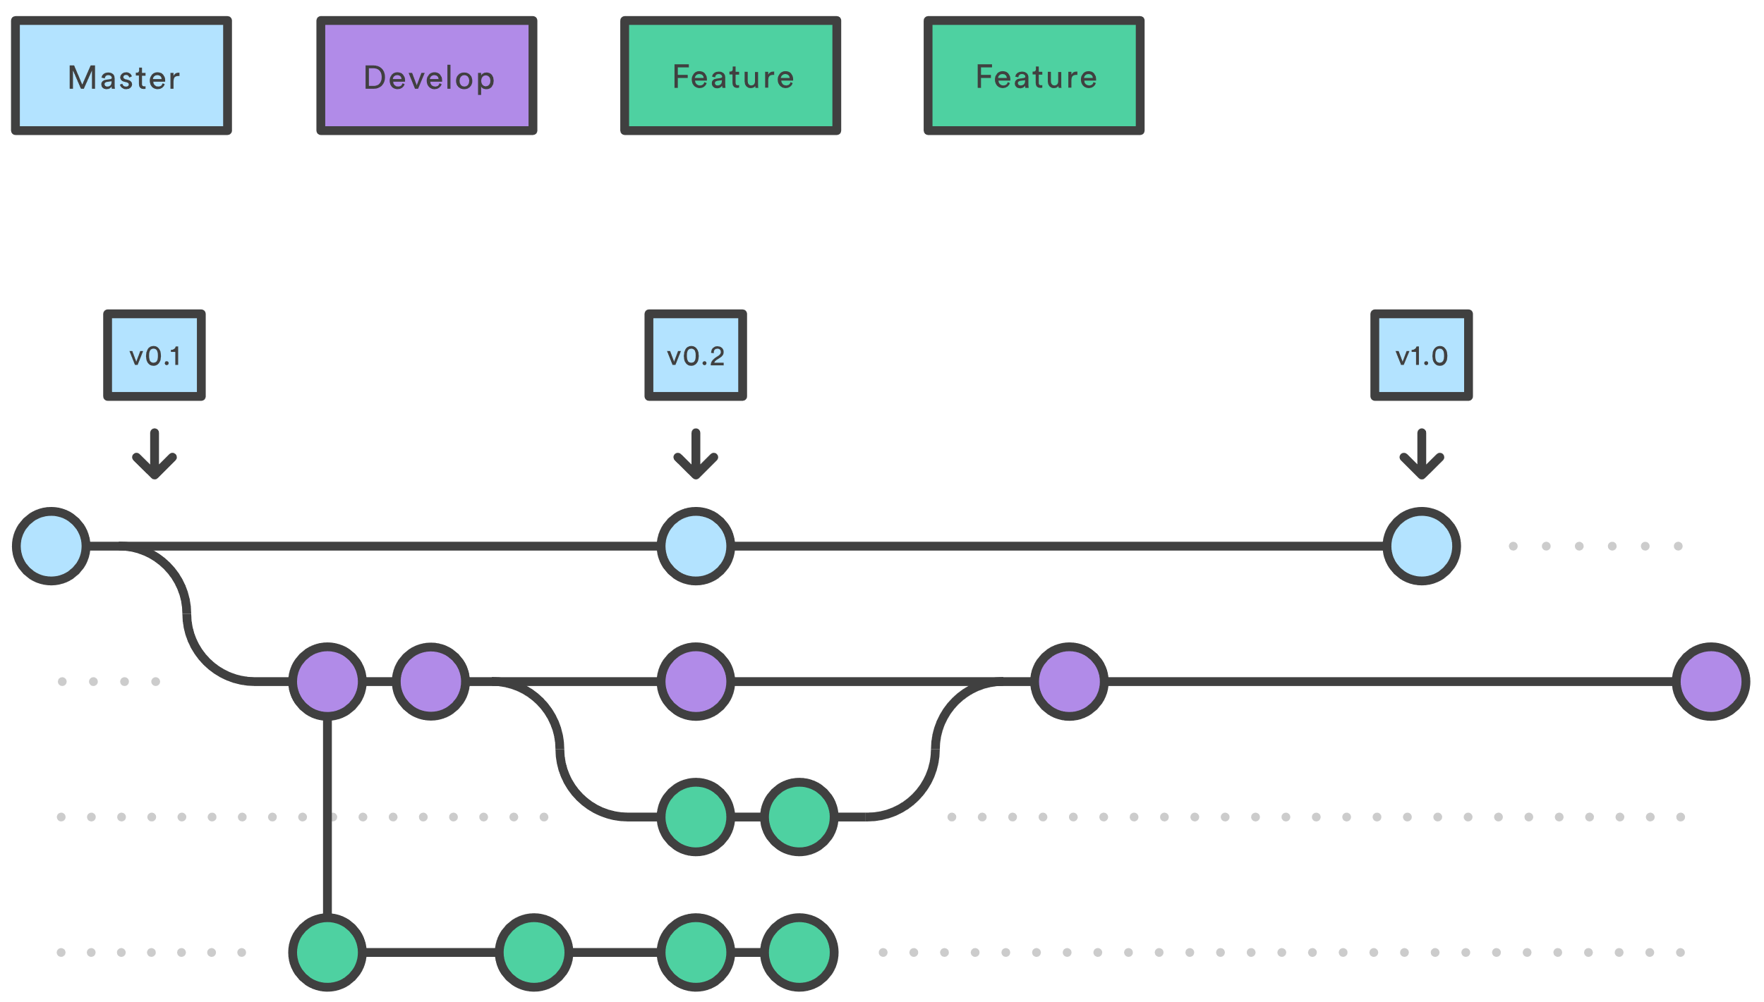
Branching strategies – Gitflow (Cont.)

Slide 6
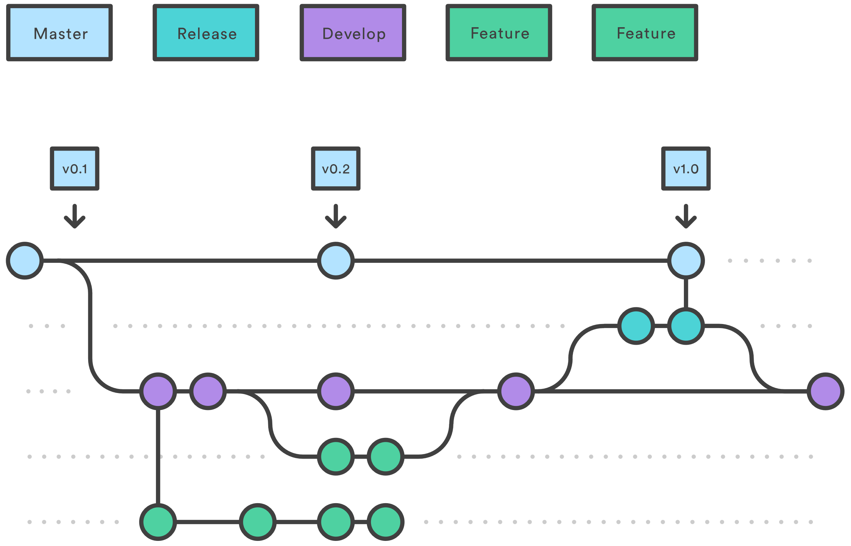
Branching strategies – Gitflow (Cont.)

Slide 7
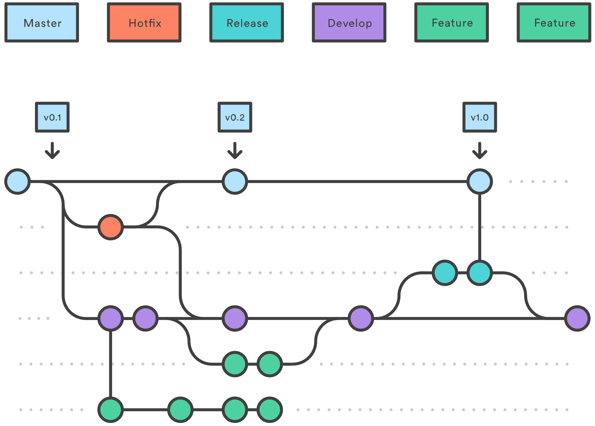
Branching strategies – Gitflow (Cont.)

Slide 8
Rebasing vs. Merging
Merging
Explicitly define what stays and what goes
A new commit with these specifications is created
Rebasing
“Replay” one branch at the end of another
Cleaner tree with no additional commit

Slide 9
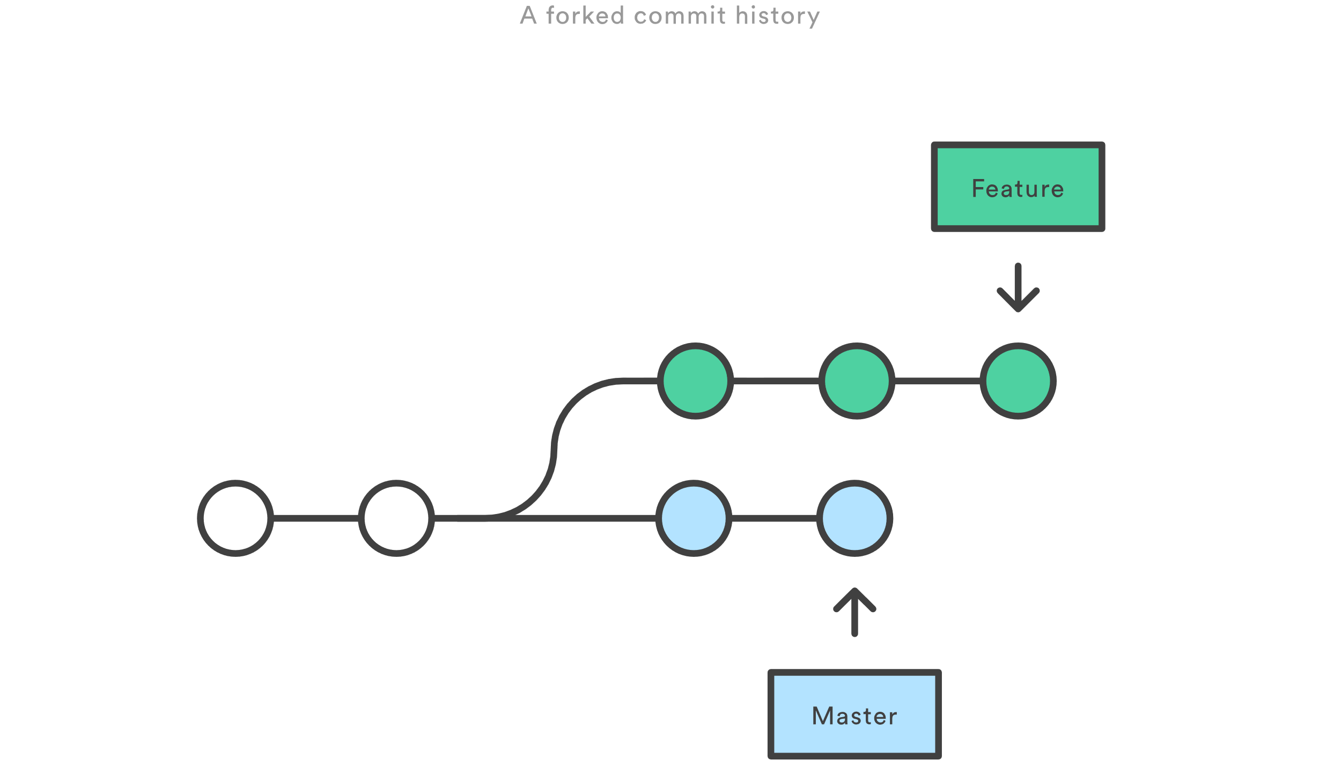
Rebase workflow

Slide 10
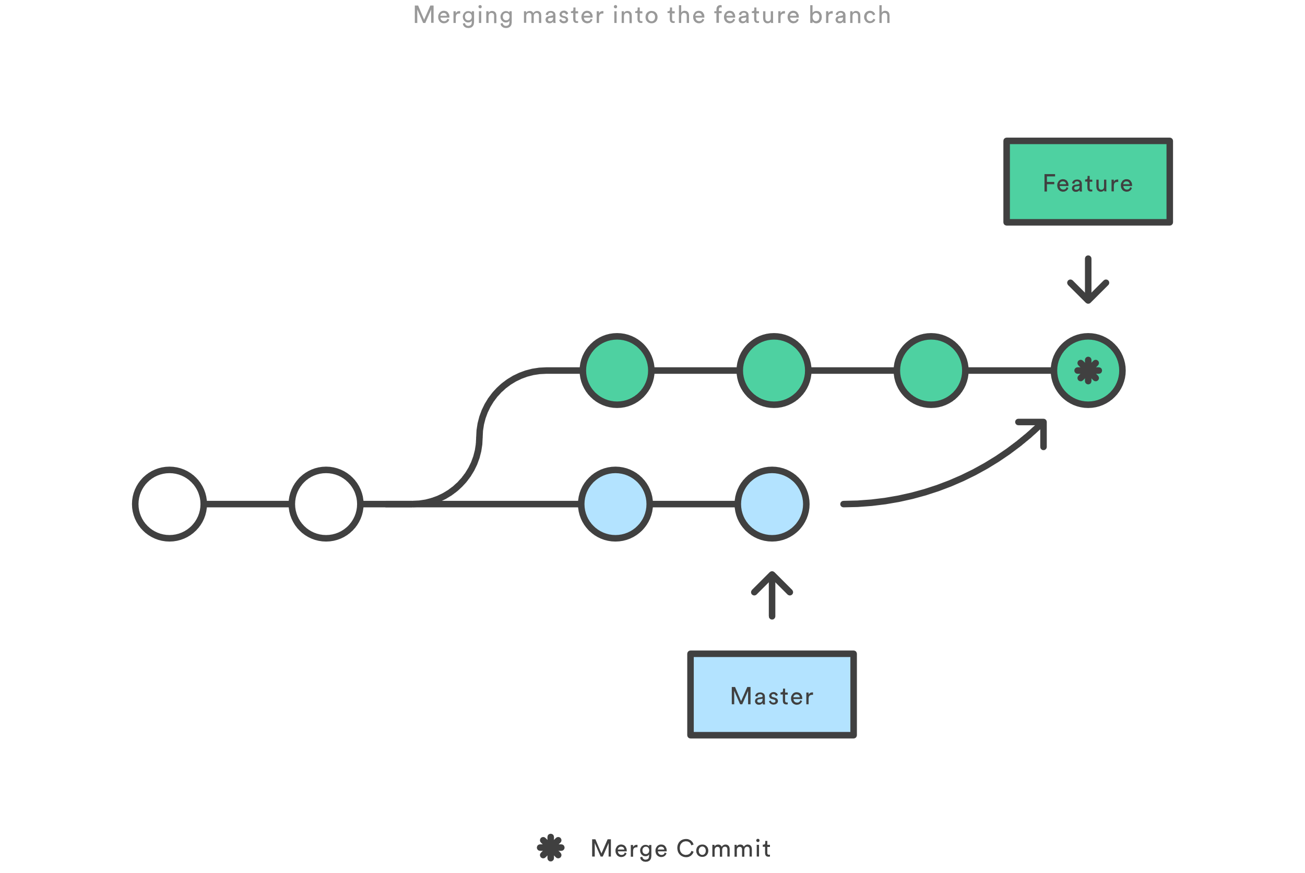
Rebase workflow (Cont.)

Slide 11
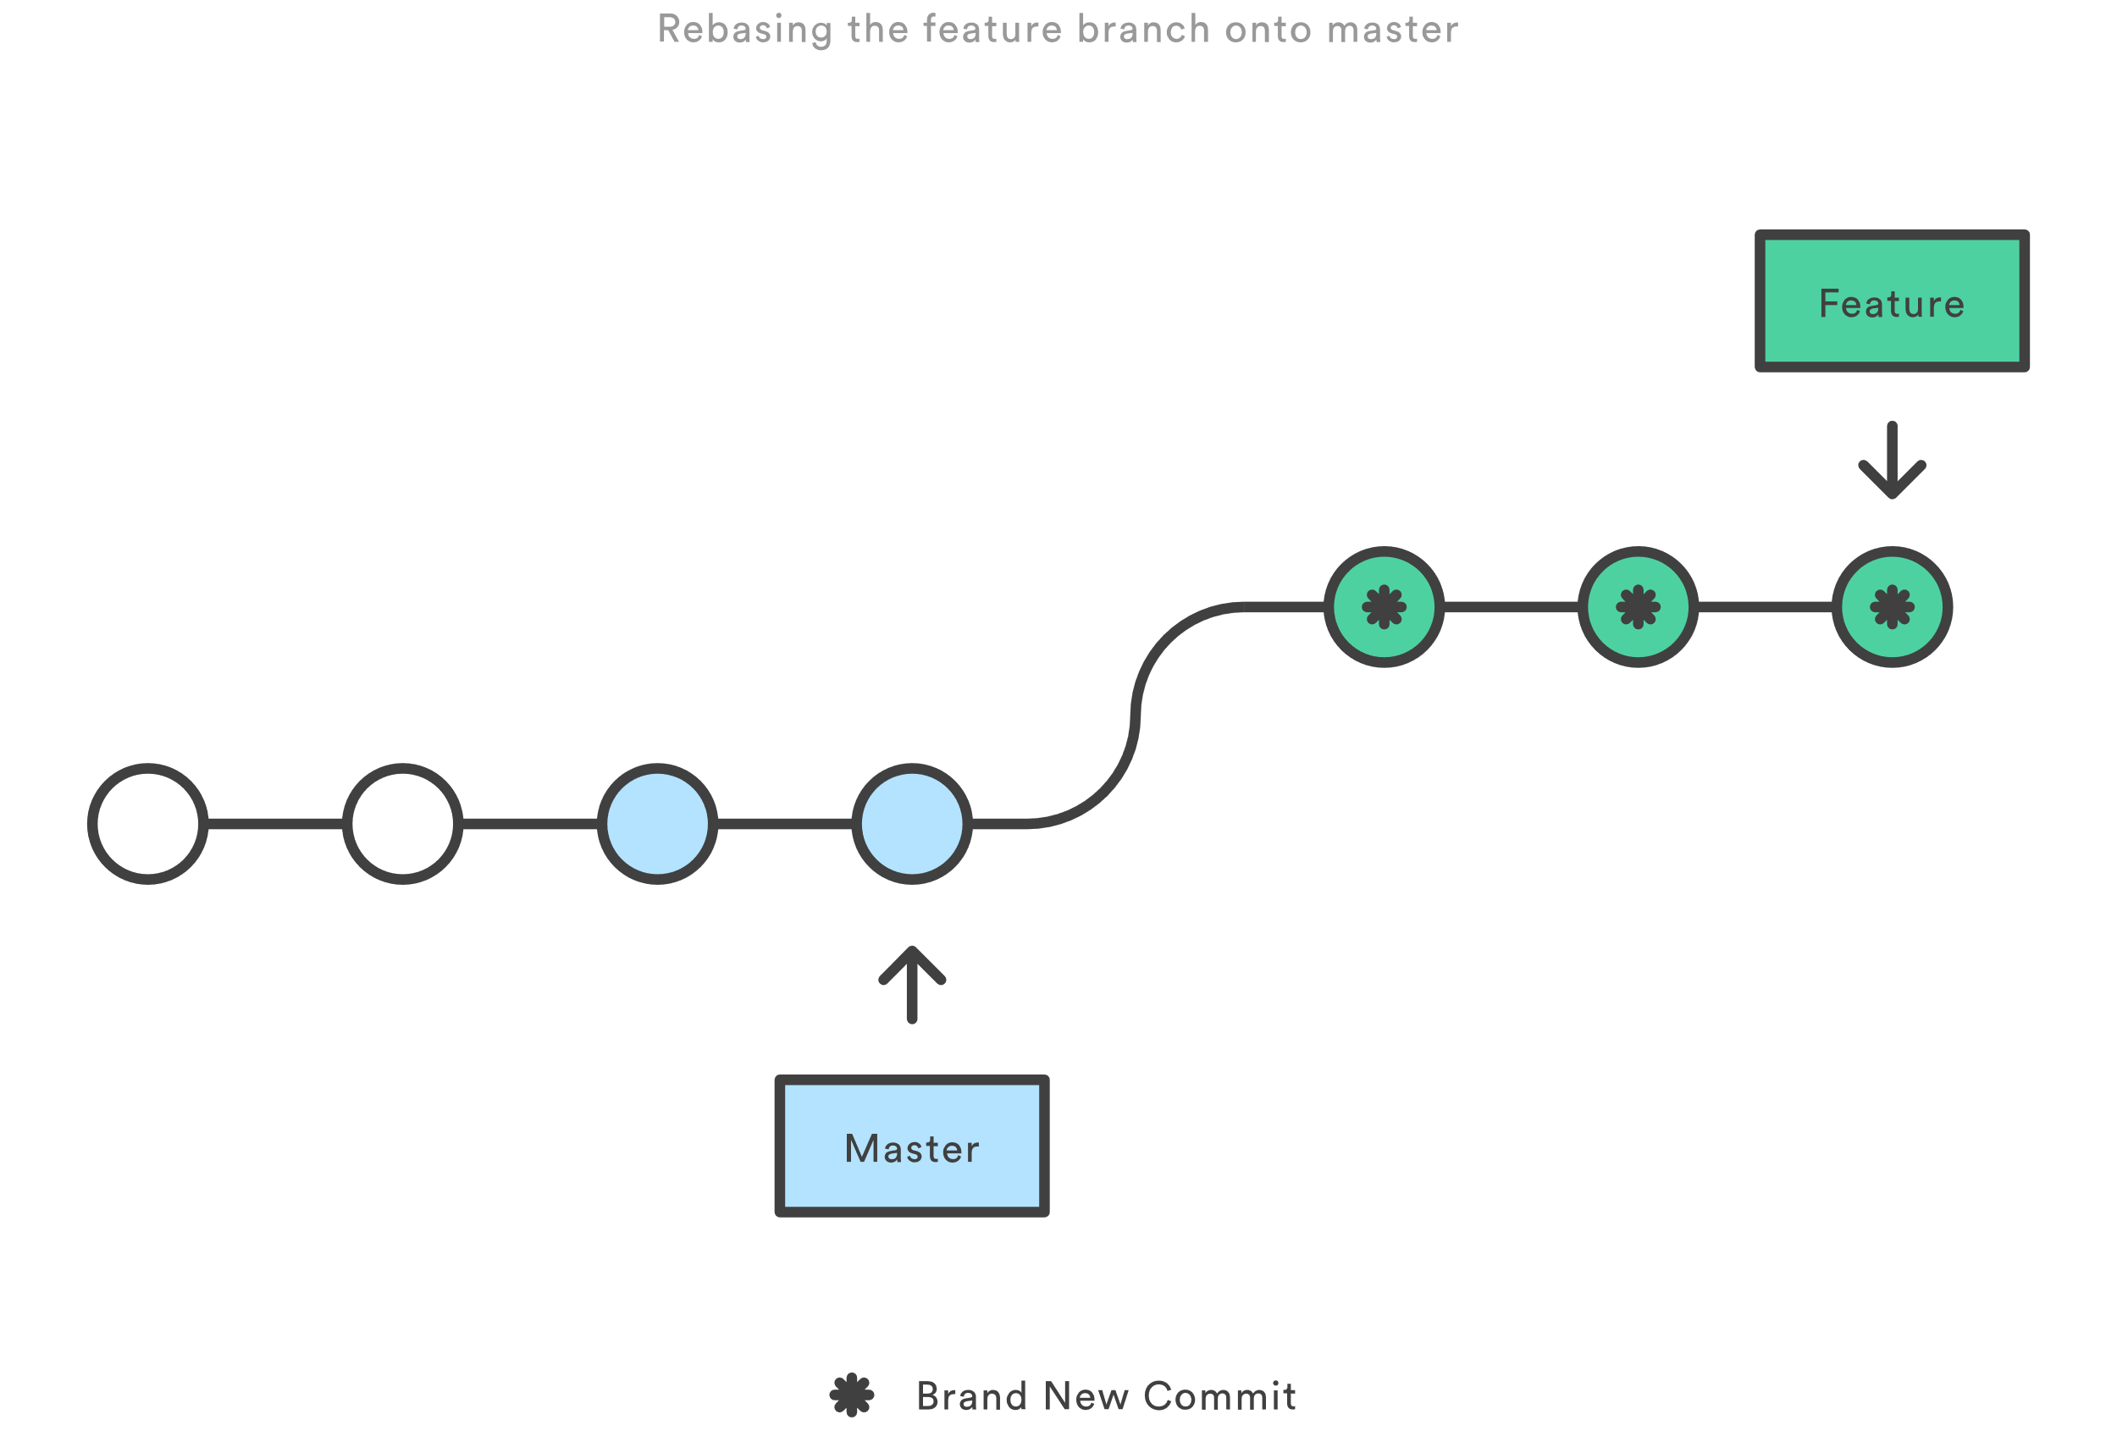
Rebase workflow (Cont.)

Slide 12
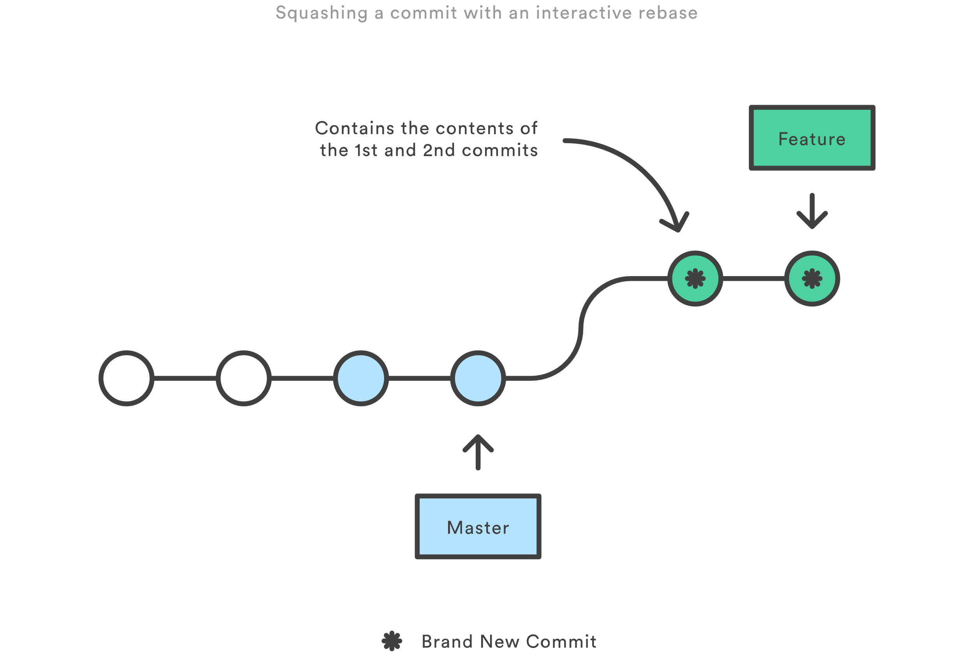
Rebase workflow (Cont.)

Slide 13
Rebase golden Rule
When rebasing, keep the golden rule in mind:
NEVER rebase a public branch over your branch
Rebasing gives you an opportunity to realign your history with team changes
Don’t make others have to realign around your own changes

Slide 14
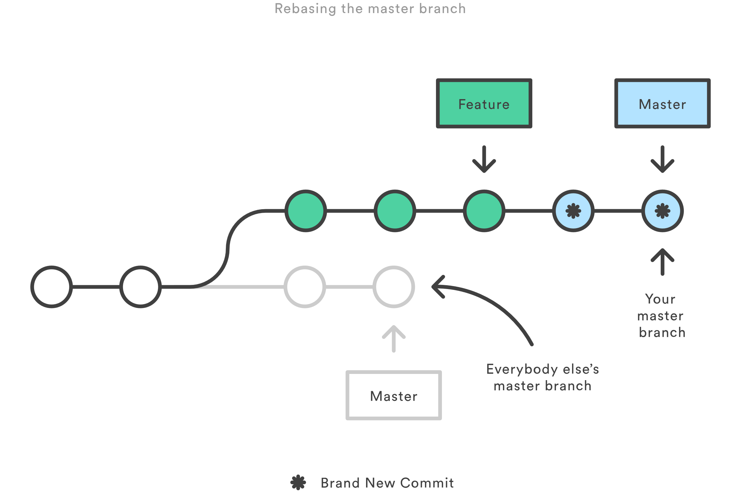
Rebase golden Rule - Illustrated

Slide 15
Leadup to lab 1
Rebase not only helps keep a clean tree, it can reduce clutter
Maintaining clean commit histories can be challenging
Consolidating commit messages and removing unnecessary commits
Alter history itself! (You can do some weird stuff with rebase!)
Important rebase terms:
Pick
Squash
Edit
Reword
Drop

Slide 16
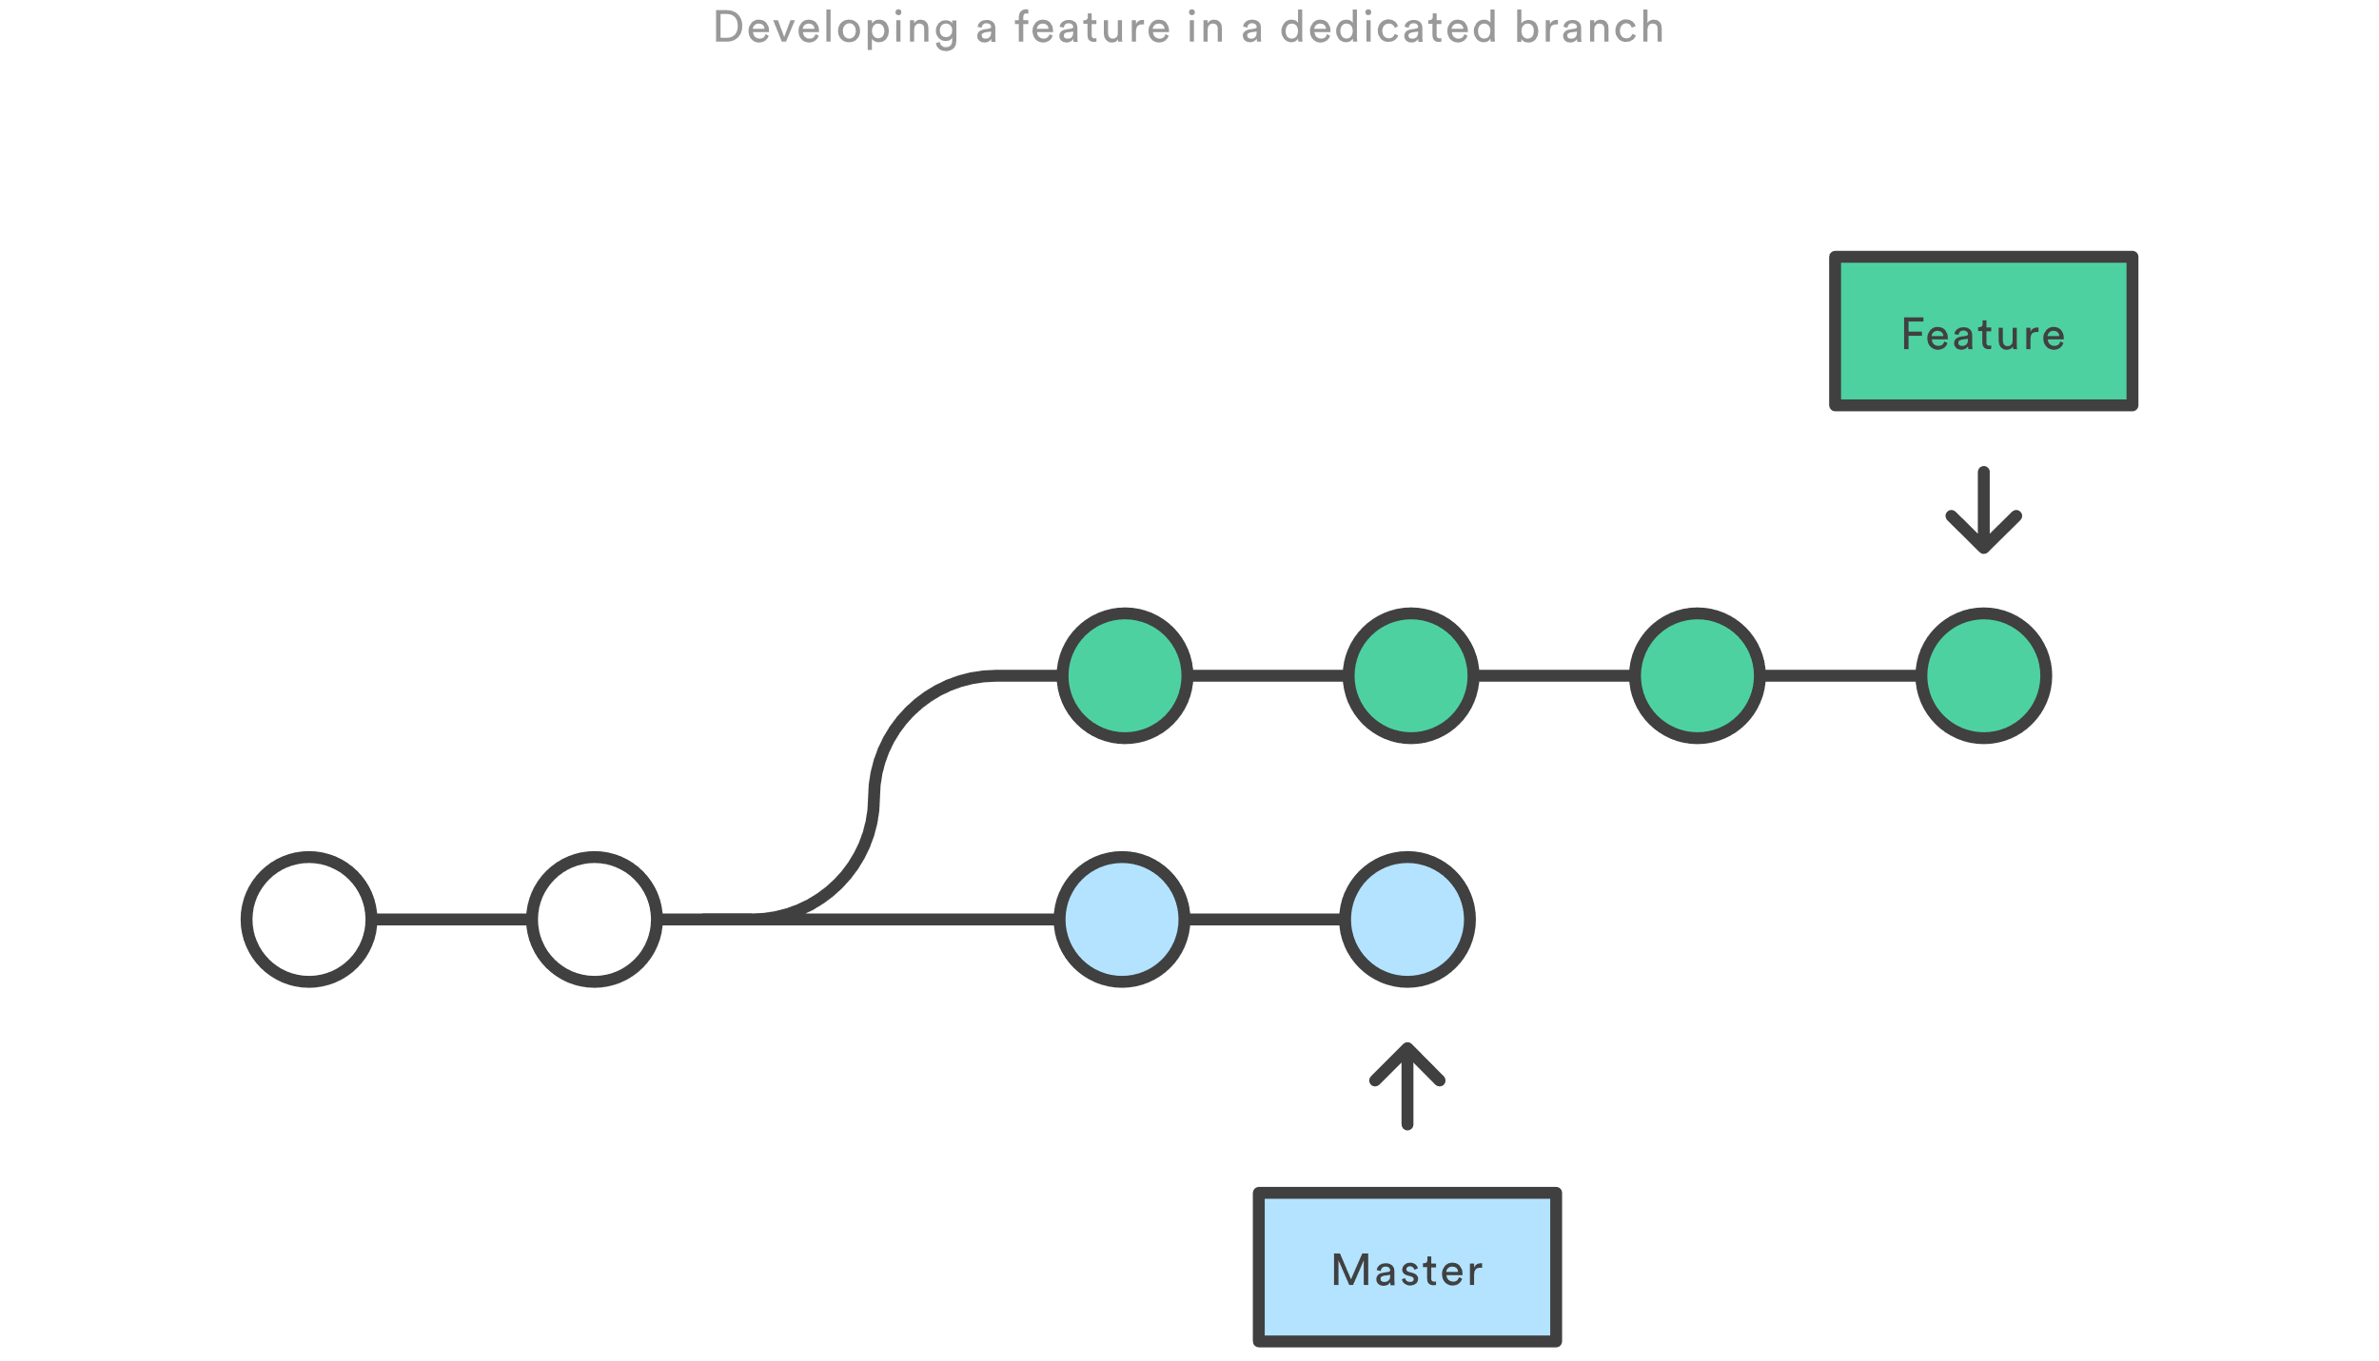
Lab 1 – Interactively rebasing

Slide 17
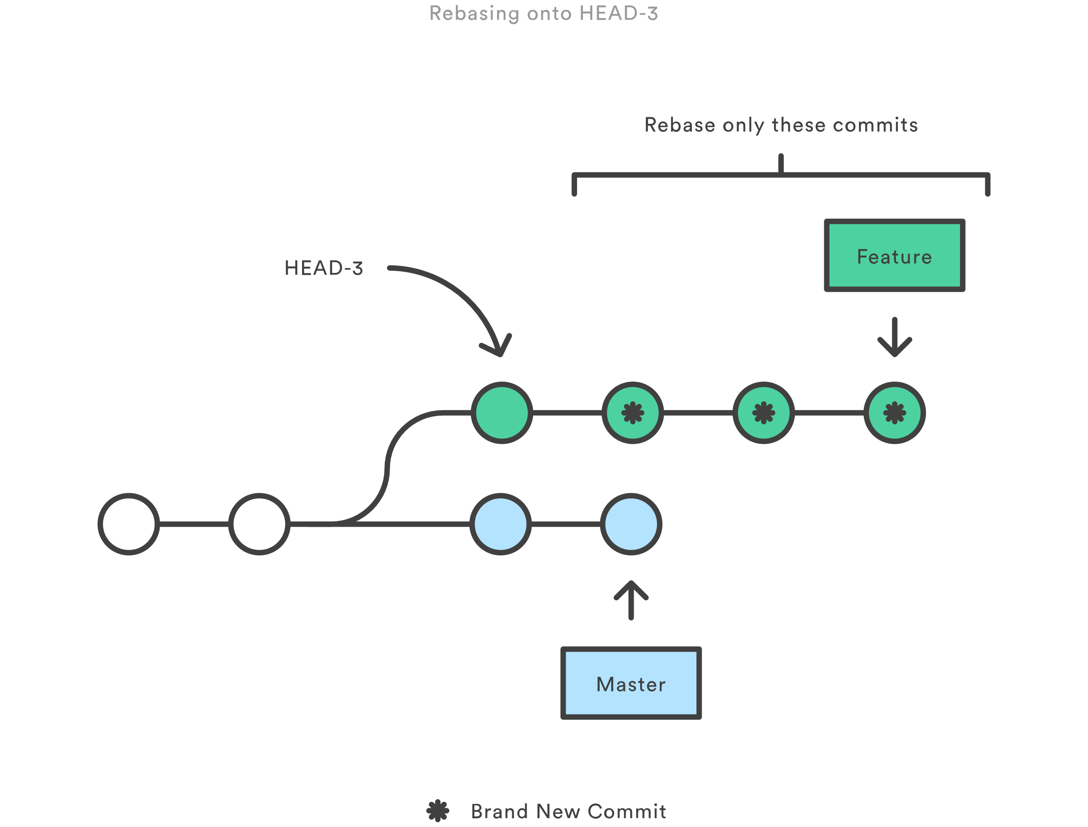
Lab 1 – Interactively rebasing

Slide 18
Lab 1 – Interactively rebasing
Create a new branch, called lab_1, and change to that branch
git branch lab_1
git checkout lab_1
Make a minor change, for our example we’re creating a temp file and updating it, and then commit that change with the commit message “commit 1”
echo “change 1” >> tmp.txt
git add tmp.txt
git commit –m “commit 1”

Slide 19
Lab 1 – Interactively rebasing (Cont.)
Do the same steps we did before, twice more, but incrementing the commit message by one each time (“commit 2”, “commit 3”)
echo “change #” >> tmp.txt
git add tmp.txt
git commit –m “commit #”
Once finished, confirm that all commits and changes are in place and no files are pending commit (this prevents a rebase from occurring)
cat tmp.txt
git status
git log

Slide 20
Lab 1 – Interactively rebasing (Cont.)
We’re now ready to interactively rebase and clean up our commit history
git rebase –i HEAD~3
Squash commits 2 and 3 in the editor
Clean up the final commit message to now say “commit 1 with changes 1, 2, and 3”
git log
We now have a cleaner git history

Slide 21
Tags
Tags are used to indicate a significant milestone in the branch history
These are usually indicative of a version release
Unlike branches, after a tag is created it has no further history
Tags provide a static reference a specific point your git tree history
Usage
git tag <tagname> - Creates a tag of <tagname>
git tag – Lists all tags in the branch history

Slide 22
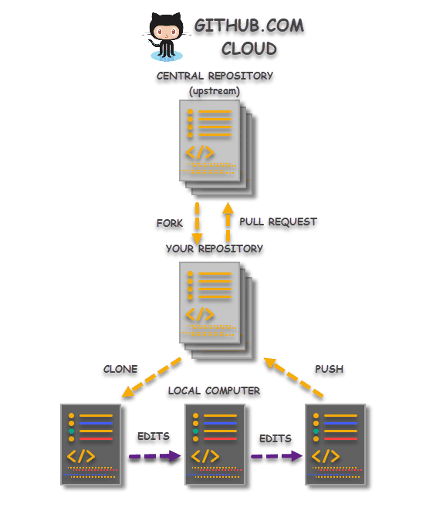
Forking workflow
The Forking Workflow is most often seen in public open source projects.
The main advantage is that contributions can be integrated without the need for everybody to push to a single central repository

Slide 23
Branching differences
Everybody should still be using branches to isolate individual features, the only difference is how those branches get shared.
In the Forking Workflow, they are pulled into another developer’s local repository, while in the Feature Branch and Gitflow Workflows they are pushed to the official repository.

Slide 24
Getting started
All new developers to a Forking Workflow project need to fork the official repository
Forking is just a standard git clone operation
This will clone the original repository to our own server-side repository
Git hosting services automate this step without the need of SSH’ing into a server to clone

Slide 25
Clone your fork
Clone your own public forked repo
This can be done with the familiar git clone command
Git clone https://github.com/user/repo.git

Slide 26
Adding a remote
The Forking Workflow requires two remotes
one for the official repository
one for the developer’s personal server-side repository
A common naming convention is to
use origin as the remote for your forked repository
This will be created automatically when you run git clone
upstream for the official repository
git remote add upstream https://github.com/user/repo.git

Slide 27
Making changes
In your local copy of the forked repository, you can edit code, commit changes, and create branches just like in other Git workflows
If the official repo has moved forward, you can get the latest change with “git pull upstream master”

Slide 28
Submitting code to the official repo
Now you’re ready to make your new feature available!
First, you have to make your contribution accessible to other developers by pushing it to your public repository
git push origin feature-branch
Second, you need to notify the project maintainer that they want to merge their feature into the official codebase
Github provides a “new pull request” button that leads to a form asking you to specify which branch you want to merge into the official repository.
Typically, you’ll want to integrate your feature branch into the upstream remote’s master branch.

Slide 29
Advanced Github Features
Enough with non-github stuff, we git it! (Get it?)
Actions and Workflows to build a CI/CD Pipeline
Templates
Secrets and how to use them
Pull Request Management
Issue Tracking and Projects

Slide 30
Actions, Secrets, and Workflows
Secrets are important pieces of information that you want to remain hidden
This is likely to be username and passwords for services that your workflow may use
Secrets are essentially hidden environment variables
Workflows can be whatever you need them to be
This could be a CI/CD (Continuous Integration / Continuous Deployment) Pipeline
Automatically tag specific branches as they come in
Immediately raise new issues when found
FTP files to a specific destination upon merge
Countless other scenarios…

Slide 31
Lab 2 – Let’s make a secret
Setting up Secrets for your Repository if easy!
Select Settings from the top ribbon on your repository homepage
Select Secrets from the left navigation panel
Click “Add a new secret” to start adding your secret
Our secret Name is “LAB_SECRET” – This is the variable name used
Our secret Value is “This will be our secret!” (Alternatively, you can input whatever you’d like here, up to 64KB in size)
Click Add secret to finalize adding the secret
Note: Any repo can have a maximum of 100 Secrets associated with it

Slide 32
LAB 2 – Our workflow and secret
Now that we have a secret, let’s make a workflow to use it
Select Actions from the ribbon at the top of your repository homepage
Here you’ll see a number of workflows that are pre-built, but we’re going to make our own
Select “Skip this: Set up a workflow yourself” in the top right of the page
Let’s pause to discuss YML files

Slide 33
Lab 2 – The intermission
YML or YAML is a recursive acronym for “YAML Ain’t Markup Language”
Similar to JSON, but uses white space to denote structure
It’s minimal syntax footprint has helped it gain popularity
Key-Value pairs are denoted by colons ‘:’
Key advantages over other data-serialization languages
Multiple documents in a stream can be denoted through ---
Data typing through implicit and explicit denotation
References for repeated nodes allows for brevity

Slide 34
Lab 2 – Workflow completion
Change the file name to lab2.yml
Change the name of the workflow to Lab 2 Workflow
Remove all lines after line 13
Update line 13 to reflect the following:
run: echo Our secret is ${{ secrets.LAB_SECRET }}
Alternatively, copy the contents of my example file from the link provided on the website for Lab 2
Commit the file to your repo using the commit button at the top right

Slide 35
Lab 2 – Workflow completion
Watch your new workflow in action!
Click on Actions on the top ribbon
Select Lab 2 Workflow from the left nav panel
Click on the latest build of your Lab 2 Workflow
Click on the “build” link to the left to review the logs of the build process
Expand the collapsed item “Run a one-line script” so we can see our secret!
What happened?

Slide 36
Pull Requests
Pull requests (or PRs) represent a formal workflow to introduce code from one branch to another
There is typically a review process for pull requests
PRs provide a history for your repository beyond branches and commits
PRs can have rules to, including but not limited to, do the following:
Make sure all code passes tests before it can be merged
Meets the minimum number of approvers
Expires if too much time has passed
Clear previous approvals if the contributor pushes additional changes to the branch to be merged

Slide 37
Templates
Functionally similar to forking, but github specific
Quickly bootstrap new projects
Easily defined and maintained

Slide 38
Issue tracking and projects
Projects helps consolidate the work specific to a certain effort
A project need not be limited to a single repository
Most larger projects will have numerous repositories attached
Kanban boards are a common work management tool to quickly visualize and progress items in need of completing
Issues can be triaged directly from your project screen to be sorted on the kanban

Slide 39
Issue tracking and projects (Cont.)
Issue tracking acts as a funnel for all work coming into your project
This doesn’t have to be explicitly issues in the sense of bugs or problems
Enhancements or new features are classified as “issues”
Requests for additional documentation are issues as well
As new issues are tracked, labels can help sort out the work
Items tagged with “good first issue” are terrific for newcomers to your project (or a great target if you want to start helping on someone else’s project)
“Help wanted” can indicate that the issue has exceeded the capacity of the current assignee, so they’re looking for more hands to solve the problem

Slide 40
Presentation Objectives Revisited
Gitflow Strategy Refresher
Advanced Git Tactics
Rebase – What it is and when to use it
Forking vs. Cloning
Tags
Advanced GitHub Features
Actions and Workflows to build a CI/CD Pipeline
Templates
Secrets and how to use them
Pull Request Management
Issue Tracking and Projects

Slide 41
Presentation End – open lab and questions
Can’t think of a question or need to leave before I can answer?
No worries! Send me an email – zach@zach-martin.com

